Slide 1
Bio-Inspired High Speed Gaze-Tracking using a Dynamic Vision Sensor
Notes:
Aim:
Perform online gaze-tracking using a dynamic vision sensor
Hasn’t been done yet
Potential for high-speed tracking
Achievable accuracy unknown

Slide 2
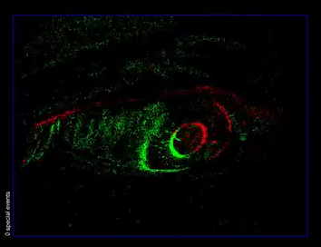
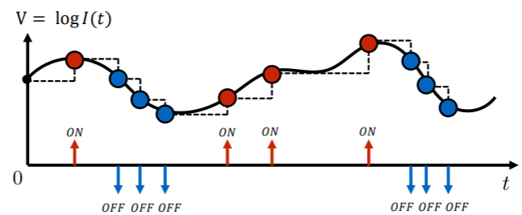
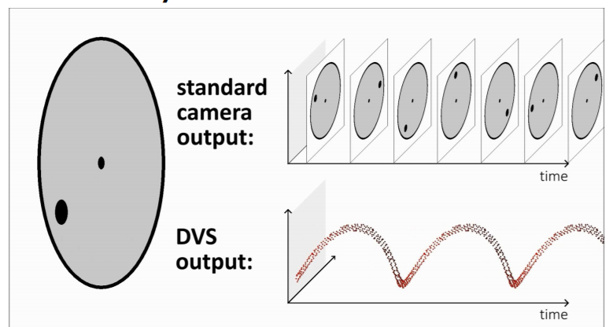
Dynamic Vision Sensors (DVS)
Lichtsteiner P, Posch C and Delbruck T. A 128× 128 120 dB 15 μs latency asynchronous temporal contrast vision sensor. IEEE; 2008.
Scaramuzza D. Tutorial on Event-based Vision for High-Speed Robotics. Lecture presented at; 2017; Robotics and Perception Group, University of Zurich
Notes:
Recap DVS:
Responds to changes in illumination
ON/OFF events
Removes redundancy
Asynchronous - high temporal resolution
High dynamic range (works in variety of lightings)

Slide 3
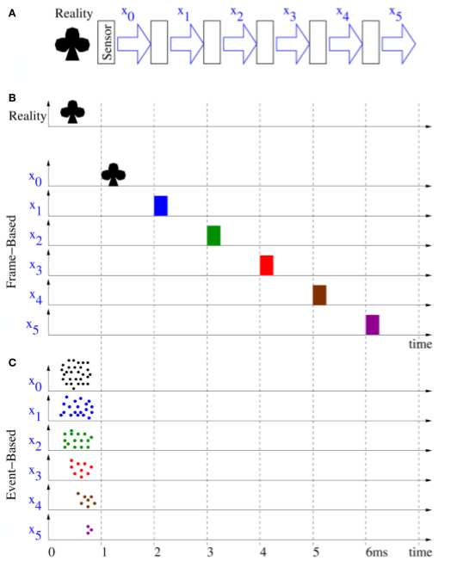
Processing DVS data
Two Methods for Processing:
Frame-based (synchronous)
Sequential image processing
Slow!
Event-based (asynchronous)
Operate on events as they come
Leverage advantages of DVS!
Mirrors biology
Farabet C, Paz R, Pérez-Carrasco J, Zamarreño-Ramos C, Linares-Barranco A, Lecun Y, et al.. Comparison between frame-constrained fix-pixel-value and frame-free spiking-dynamic-pixel convNets for visual processing. Front. Neurosci. 2012; 6:32.
Notes:
WANT TO USE ASYNCHRONOUS
Frame-based:
Count events for each pixel during time window -> frame
Waste a lot of time waiting/idle
Use conventional image processing algorithms
Synchronous i.e. frame propagates thru pipeline sequentially -> SLOW
Result: low fps (bad for gaze-tracking!)
Event-based:
Ideally want to use events as they come!
Asynchronous i.e. events propagate in parallel along pipeline indep.
Allows rapid processing/inference
V similar to biology -> VC

Slide 4
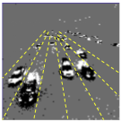
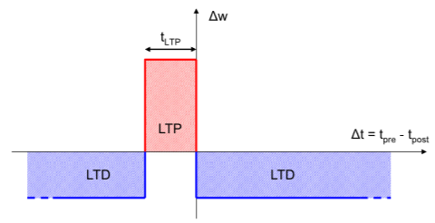
Spiking Neural Networks
Unsupervised Learning
Spike-timing-dependent Plasticity (STDP)
Extract frequently occurring features
Drawback: needs external (often synchronous) classifier
Supervised Learning
Difficult as can’t use standard backpropagation
Bichler O, Querlioz D, Thorpe SJ, Bourgoin J and Gamrat C. Extraction of temporally correlated features from dynamic vision sensors with spike-timing-dependent plasticity. Neural Networks. 2012; 32 339-348.
Notes:
Recap SNN:
- Neural networks that communicate with spikes
Two training methods
Unsupervised
V good at learning features
shown to work on DVS for car tracking
Use STDP -> LTP/LDP
Needed SVM -> synchronous
WILL NEED SUPERVISED COMPONENT TO MAP GAZE-POSITION
IDEALLY WANT ASYNCHRONOUS OUTPUT
Supervised
Spoke about how spikes discont.

Slide 5
Project Recap
Asynchronous learning algorithm
SNN
Map event-stream to gaze position
Supervised problem
Ideally entire algorithm is asynchronous
Online

Slide 6

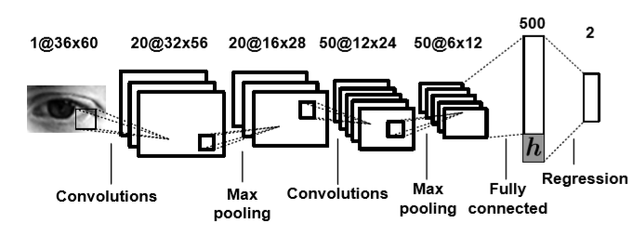
Supervised Learning in ANNs for Gaze-tracking
Need to map input to (x, y) or (θ ,Ф) gaze-position coordinates
Classification
Divide visual space into n x n grid
2n binary output units
Gaussian shaped encoding instead of 1-hot encoding
Regression
2 continuous output units
Baluja S, Pomerleau D. Non-Intrusive Gaze Tracking Using Artificial Neural Networks. Carnegie Mellon University, Pittsburgh, PA; 1994
George A, Routray A. Real-time eye gaze direction classification using convolutional neural network. 2016 International Conference on Signal Processing and Communications (SPCOM) : IEEE; Jun 2016
Notes:
Important to define problem before tackling supervised approach
Need to know what to aim for before knowing what to train
Have a look at frame-based methods
Two approaches: regression & classification

Slide 7
SNN Output for Gaze-tracking
Nature of output determines supervised learning method
Regression or Classification?
2 ways to implement:
Synchronous Classifier/Regressor e.g. SVM
Requires time windowing
Asynchronous Classifier/Regressor
Spike output
More difficult but lower latency
Notes:
- How does this apply to SNNs?

Slide 8
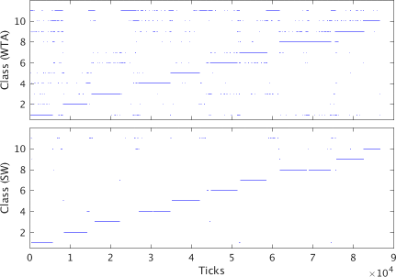
Ideas for Spiking SNN Output
Classification
Single output neuron for each discrete gaze-position
Winner-takes-all (WTA) mechanism – i.e. spike id = class?
Binning i.e. counting spikes within time window
Population of neurons for discrete gaze-position?
Population WTA (Amir et al.)
Sliding window filter
Regression
Rate of firing proportional to output?
Requires time window to calculate -> high latency
Remove threshold and measure membrane potential as output?
Binary representation?
A. Amir, B. Taba, D. Berg, T. Melano, J. McKinstry, C. Di Nolfo, T. Nayak, A. Andreopoulos, G. Garreau, M. Mendoza, J. Kusnitz, M. Debole, S. Esser, T. Delbruck, M. Flickner, D. Modha, "A low power fully event-based gesture recognition system", The IEEE Conference on Computer Vision and Pattern Recognition (CVPR), July 2017
Notes:
Binning – population improves performance

Slide 9
Supervised Learning Methods in SNNs
Conversion from ANN to SNN
Assumes synthetic data as input to SNN
Synthetic data not a good representation of event data!
Stromatias et al. propose method to train from feature data
Learning directly from spikes
Tricky as spikes discrete
Lee et al. propose backpropagation on membrane potential
Stromatias E, Soto M, Serrano-Gotarredona T and Linares-Barranco B. An event-driven classifier for spiking neural networks fed with synthetic or dynamic vision sensor data. Front. Neurosci; 2017.
Lee JH, Delbruck T and Pfeiffer M. Training deep spiking neural networks using backpropagation. Front. NeuroSci; 2016

Slide 10
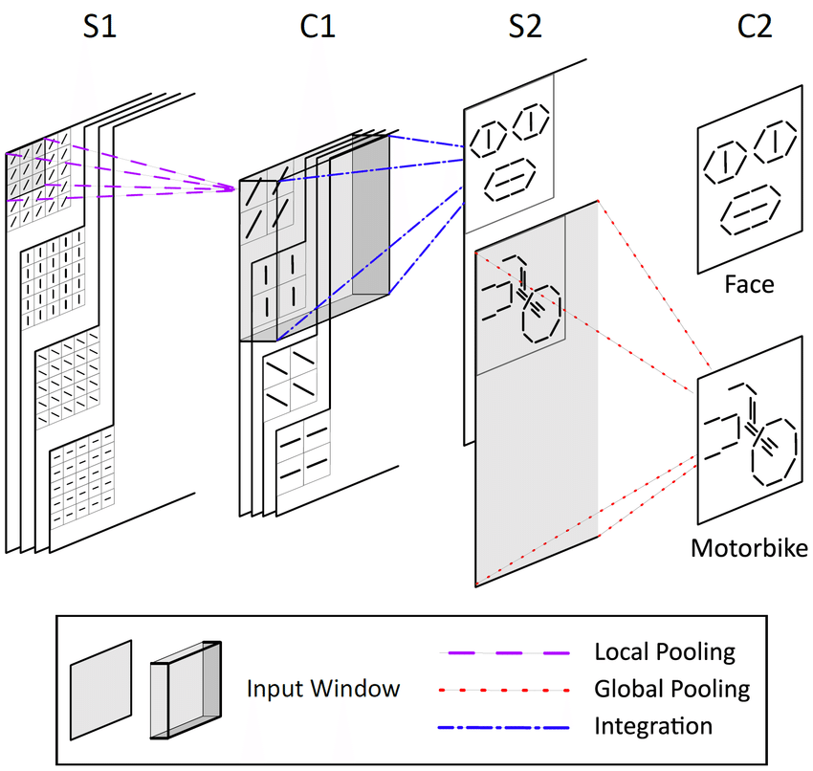
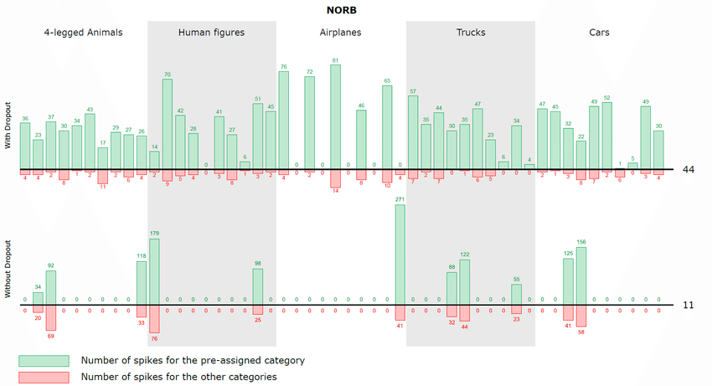
First-spike based visual categorization using reward-modulated STDP
Supervised spiking classifier
Outperforms SNN+SVM
Reinforcement Learning to reward/punish neurons in S2 layer
Correct classification = reward = STDP in S2 neuron
Dropout & adaptive learning rates to avoid overfitting
Drawback: impractical for many class classification
Mozafari, M., Kheradpisheh, S. R., Masquelier, T., Nowzari-Dalini, A., & Ganjtabesh, M. (2018). First-Spike-Based Visual Categorization Using Reward-Modulated STDP. IEEE Transactions on Neural Networks and Learning Systems
Notes:
Asynchronous
S2 is lots of grids, each corresp to feature for specific class
Therefore if 10 classes with 10 features each, need 100 grids -> lots of synapses!
In our case have e.g. a class per degree, means we have 180 classes

Slide 11
Implementation Requirements
Must run Online (i.e. using live DVS data)
Real-time processing
Real-time camera-PC communication
Learning may be done offline

Slide 12
SNN Implementation
CPU/GPU based – may need linux
XNet
NEST
Megasim
Neuromorphic Hardware
SpiNNaker
TrueNorth
DVS camera
jAER
cAER

